Slide 1
Making Room: Cultivating Communities of Inclusion
ASD, AD/HD
And Your Church: What it is and How to Help
Presenter: Barbara J. Newman

Slide 2
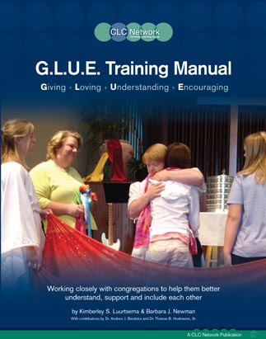
Six G.L.U.E. Steps
Step One: Read the Label
Awareness with Leaders
Step Two: Open the G.L.U.E.
Awareness with Others
Step Three: Discover the Possibilities
Getting to know the individual/family and the church
Step Four: Select the Right G.L.U.E.
Develop an Action Plan for individual and others
Step Five: Spread the G.L.U.E.
Share opportunities and provide trainings
Step Six: Secure the Bond
Oversee the process and recognize those involved

Slide 3

God’s View

Slide 4

God’s Pattern of Green and Pink
“For you created my inmost being; you knit me together in my mother’s womb. I praise you because I am fearfully and wonderfully made; your works are wonderful, I know that full well.”
Psalm 139:13-14

Slide 5
God’s giant body puzzle
“But in fact God has arranged the parts in the body, each one of them, just as He wanted them to be.”
1 Corinthians 12:18

Slide 6
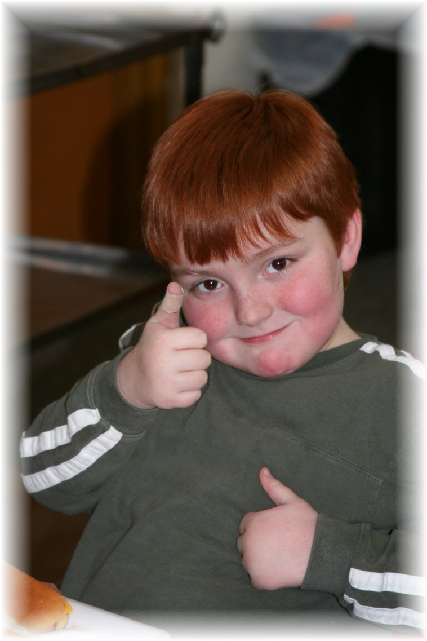
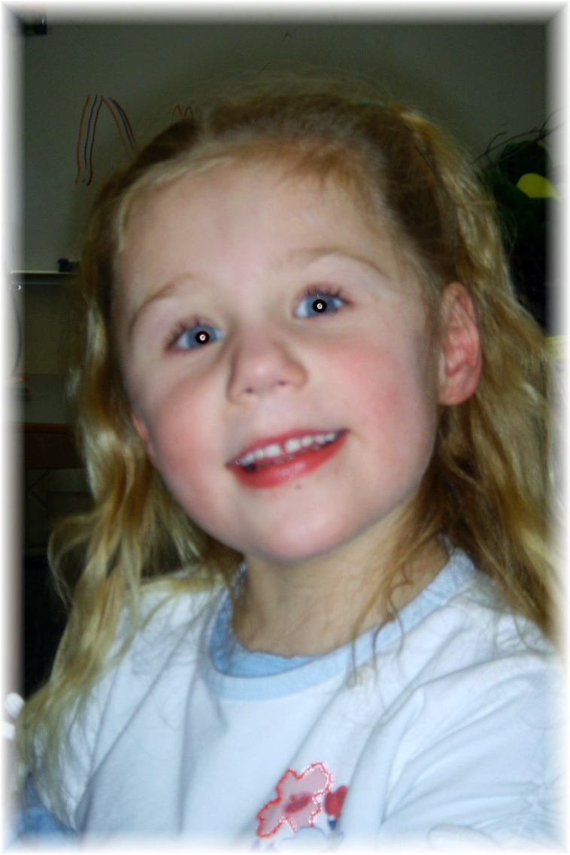
Each person, then, is a gift to be opened and cherished

Slide 7
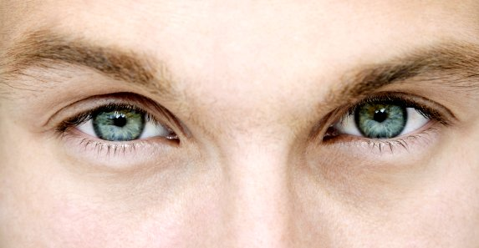
Labels, Initials, and Designations
God’s Eyes, AD/HD and ASD – Autism Spectrum Disorders

Slide 8
Attention
Memory
Short term
Active working
Long term
Attention
Control
Fuel
Input
0utput
Understanding and Using Words
(Language)
Understanding & organizing
What I see (Visual Spatial Ordering)
Understanding/ Thinking/ Problem Solving/ Concepts (Higher Order Thinking)
Making and Keeping Friends
(Social Cognition)
Keeping Track of:
Time
The order of things
(Temporal-Sequential Ordering)
Muscle and Motor Skill
Gross motor
Fine motor
Graphomotor
(neuromotor Functioning)

Slide 9
Understand the biology of AD/HD
Understand possible medication issues
Be understanding
Give choices
Add structure

Slide 10
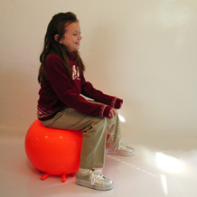
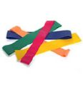
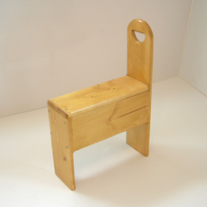
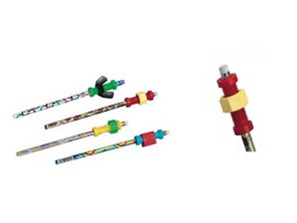
Attention

Slide 11



Attention

Slide 12
Disability: Autism Spectrum Disorder
Understanding and Using Words
(Language)
Memory
Short term
Active working
Long term
Attention
Control
Fuel
0utput
Input
Understanding/ Thinking/ Problem Solving/ Concepts (Higher Order Thinking)
Understanding & organizing
What I see (Visual Spatial Ordering)
Keeping Track of:
Time
The order of things
(Temporal-Sequential Ordering)
Making and Keeping Friends
(Social Cognition)
Muscle and Motor Skill
Gross motor
Fine motor
Graphomotor
(neuromotor Functioning)

Slide 13
Pervasive Developmental Disorders
PDD
Rett Syndrome
Childhood Disintegrative Disorder
Autistic Disorder
Asperger Syndrome
Pervasive Developmental Disorder -Not Otherwise Specified

Slide 14
Differences in Individuals with ASD
Repetitive Themes and Behaviors
Social
Language
Sensory Areas
Perspective-Taking Ability

Slide 15
“Barb’s best guess for 2013”
ASD
Autism Spectrum Disorder
Language Understanding
Social Skills
Desire for Routine
Repetitive Themes and Behaviors
Perspective Taking Ability
Sensory Responses

Slide 16
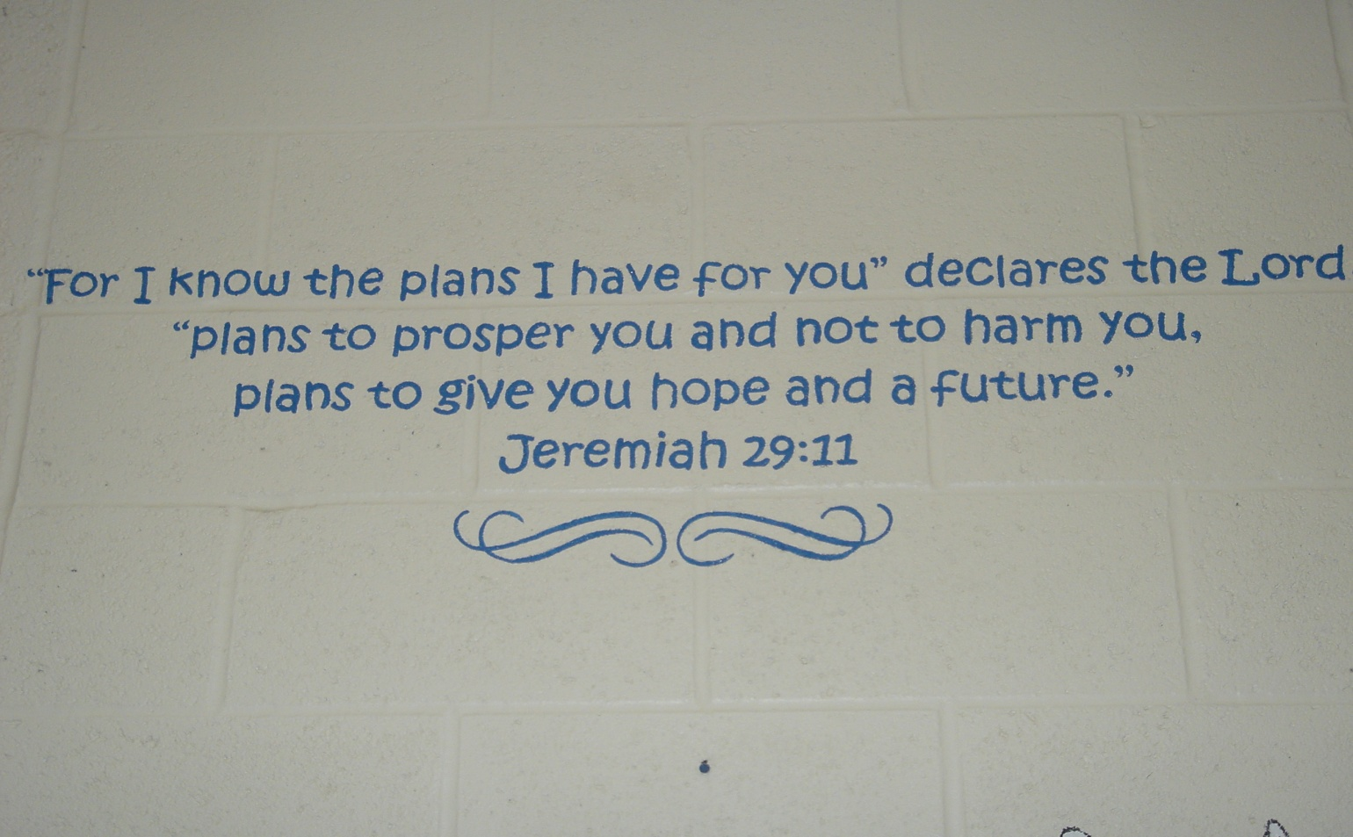
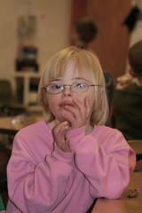
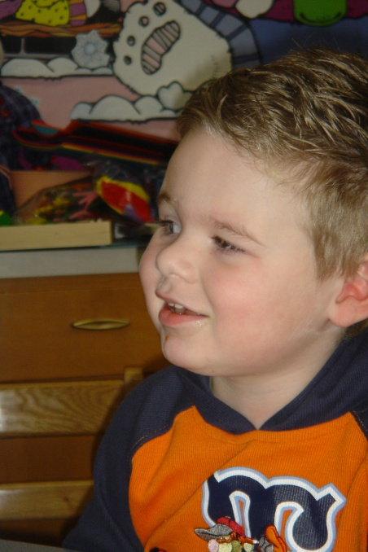
Ideas for Churches

Slide 17
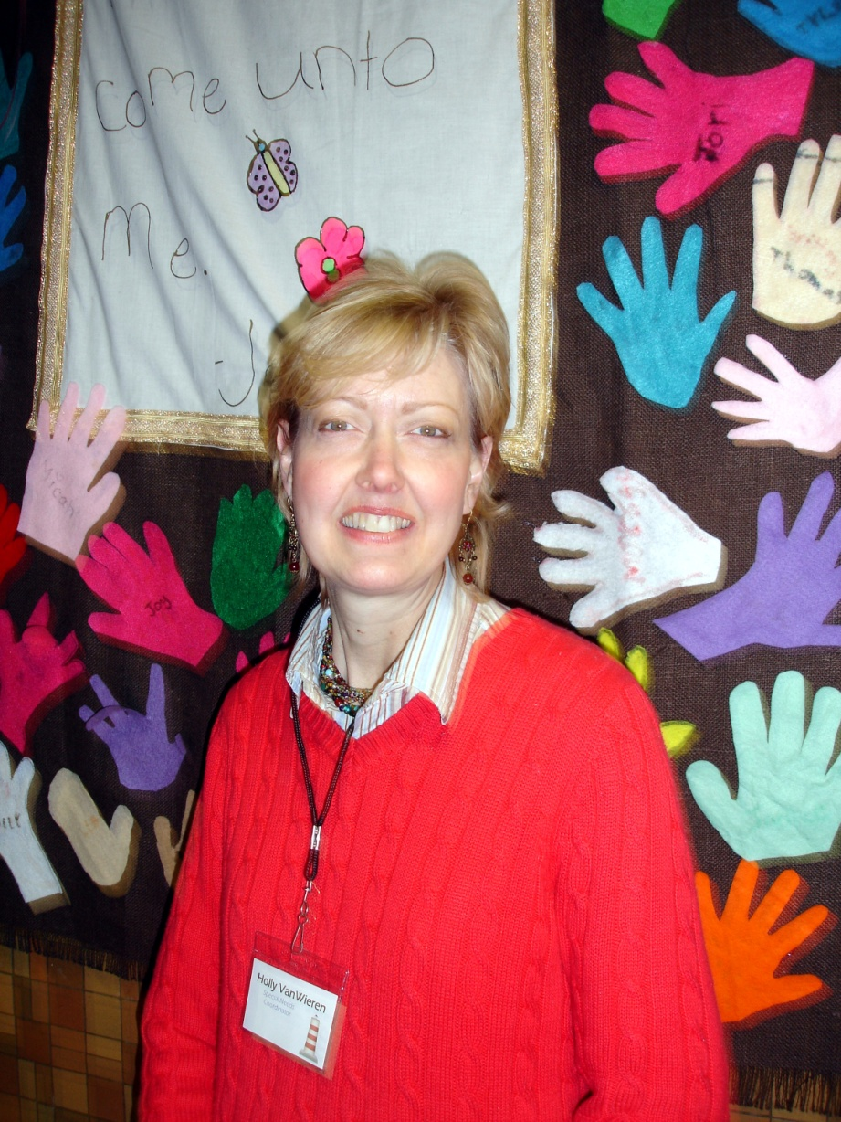
Appoint Someone to be in Charge
A Special Needs Coordinator is very important.

Slide 18
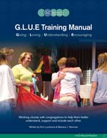
Get to know the individual.
Unwrap the package

Slide 19

Think along with that individual

Slide 20

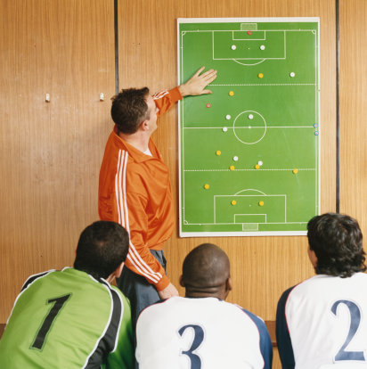
Make a Plan

Slide 21

Let church have “Green” time

Slide 22

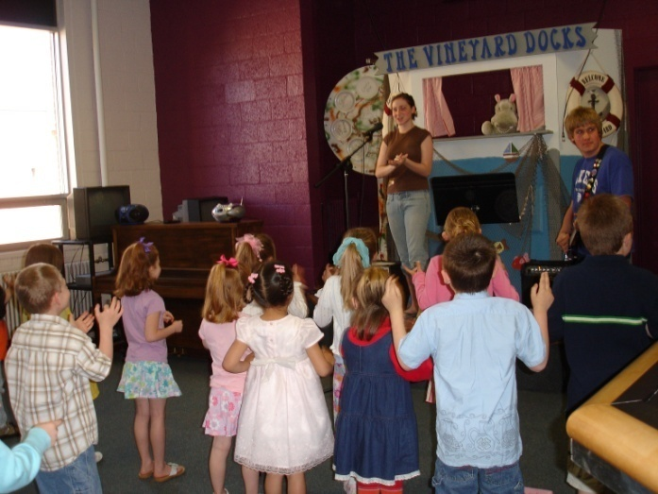
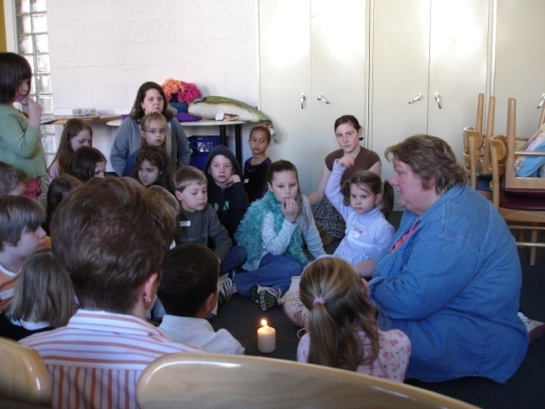

Visual Schedules for children and adults
Snack
Worship Time
Story Time
Calendar

Slide 23


First…….Then

Slide 24
Wall Wording
“Worship – 10:00 – 10:15”
“Worship – Usually 10:00 – 10:15”

Slide 25


Watch your church language.

Slide 26

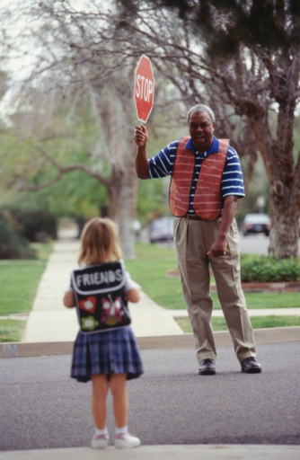
Give advanced preparation and warning.

Slide 27
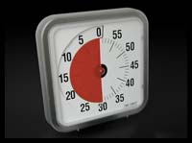
Time Timers

Slide 28

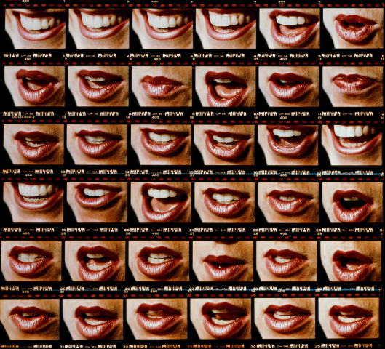
If I didn’t see it, you didn’t say it.

Slide 29

Church Welcome Story

Slide 30
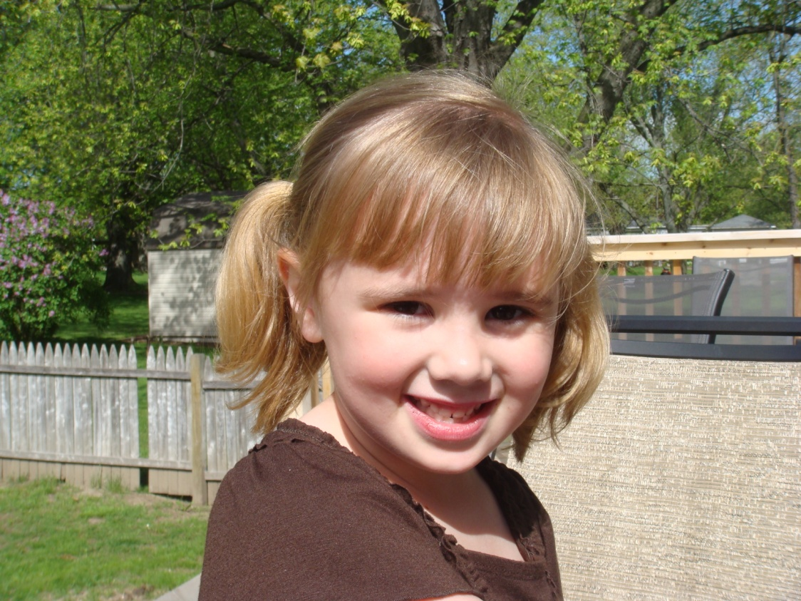
Church Welcome Story
My name is Evelyn and I want to tell you about my Sabbath school class.

Slide 31
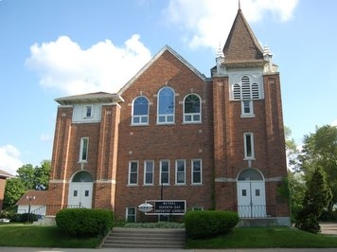
Church Welcome Story
Here is my church. It is called Bethel Seventh-Day Adventist Church.

Slide 32
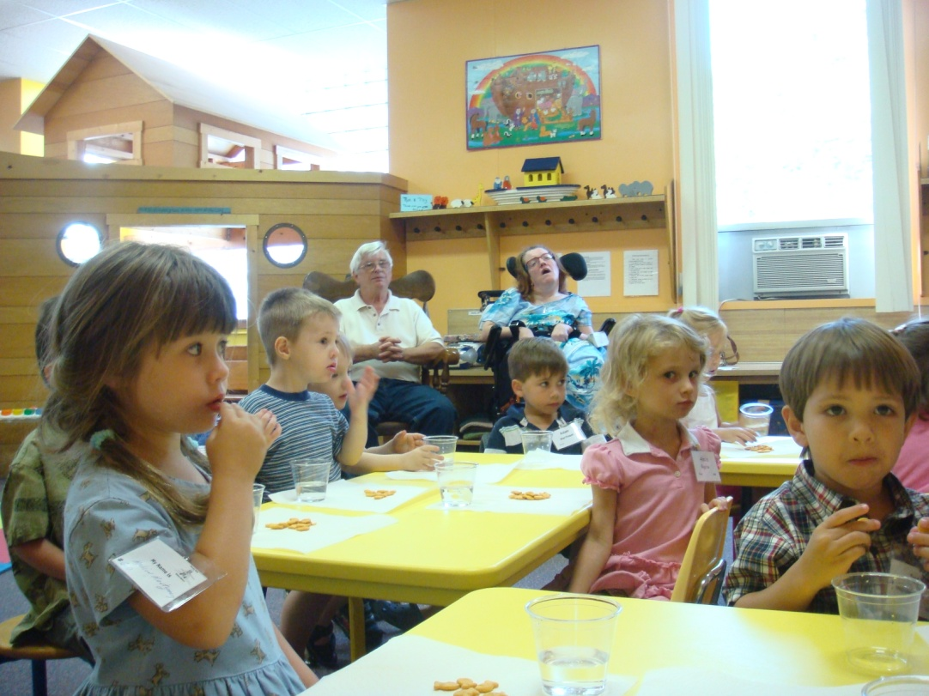
Church Welcome Story
Sometimes I stay with my family when I am at church and sometimes I go to a room for children in Sabbath school.
Here is a picture of the room where I can be with my friends.

Slide 33
Break Tickets and Sensory Overload
Break
Break

Slide 34
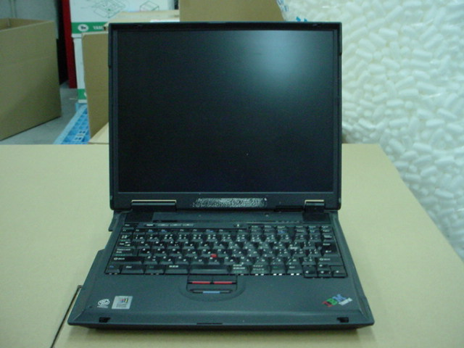
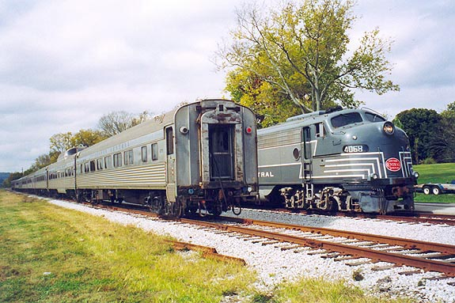
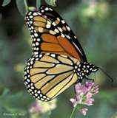

Use the areas of interest

Slide 35

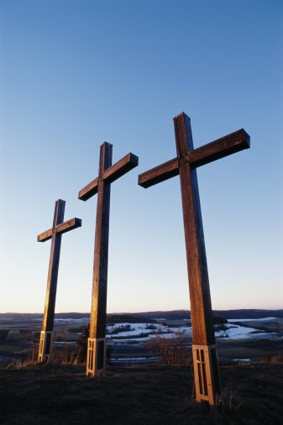



Information is Critical

Slide 36

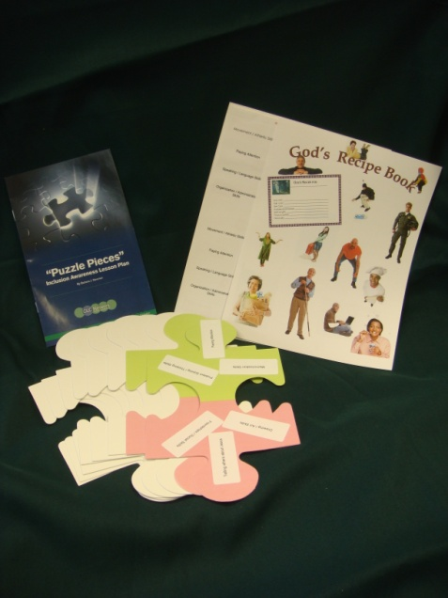





Information – by Barbara J Newman

Slide 37

Everybody Belongs – Everybody Serves

Slide 38


Additional Information

Slide 39
Possible Resources
Social Story Materials www.TheGrayCenter.org or Future Horizones 1-800-489-0727
Lockfast – Velcro and Temp Loop Fabric 1-800-543-7157
CLC Network www.clcnetwork.org

